Slide 1

Detecting fake News using Machine Learning
SUMMER TRAINING CUM INTERNSHIP 2021
By
Team no. : 05
Team members name : Arya Jad, Nishtha Singh, Neha Rani, Tulsi Kharke, Prerna
© ETI Labs
Notes:
I am here to present on

Slide 2
PROBLEM STATEMENT
In our modern era where the internet is ubiquitous, everyone relies on various online resources for news. Along with the increase in the use of social media platforms like Facebook, Twitter, etc. news spread rapidly among millions of users within a very short span of time. A fake are those news stories that are false: the story itself is fabricated, with no verifiable facts, sources, or quotes.
We aim to provide the user with the ability to classify the news as fake or real.
© ETI Labs

Slide 3
PROPOSED SOLUTION
we aim to evaluate various machine learning algorithms that can be used to quickly and effectively detect
Fake News.
Here , we will explain the Python code to load, clean, and analyze data.
we decided to focus on how a machine learning can solve the fake news problem using supervised learning
that extracts features of the language and content only within the source in question.
© ETI Labs

Slide 4
COMPONENTS USED (H/w & S/w)
VS Code
Python
© ETI Labs

Slide 5
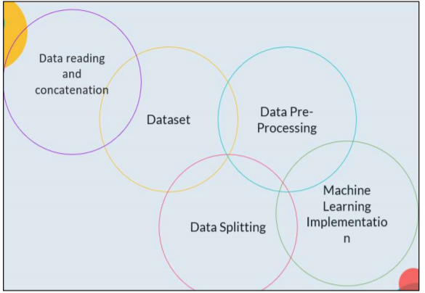
ARCHITECTURE/BLOCK DIAGRAM
© ETI Labs

Slide 6
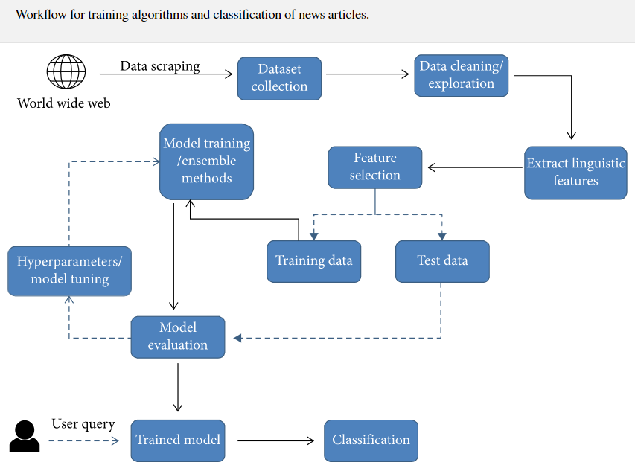
FLOW CHART
© ETI Labs

Slide 7
RESULTS
In this project we have use three algorithms :
Logistic Regression Model Algorithm : Compilation Time: 9.141 sec , Accuracy Rate: 99.04%
Decision Tree Classification Algorithm : Compilation Time: 18.992 sec Accuracy Rate: 99.68 %
Random Forest Algorithm : Compilation Time: 44.727 sec Accuracy Rate: 98.93%
Here, Decision Tree Classification algo is more better because , it is giving more accuracy then other two.
© ETI Labs

Slide 8
FUTURE WORK
Through the work done in this project, we have shown that machine learning certainly, does have the capacity to pick up on sometimes subtle language patterns that may be difficult for humans to pick up on. The next steps involved in this project come in three different aspects. The rest of aspect that could be improved in this project is augmenting and increasing the size of the dataset. We feel that more data would be beneficial in ridding the model of any bias based on specific patterns in the source. There is also question as to whether or not the size of our dataset is sufficient.
The second aspect in which this project could be expanded is by comparing it to humans performing the same task. Comparing the accuracies would be beneficial in deciding whether or not the dataset is representative of how difficult the task of separating fake from real news is. If humans are more accurate than the model, it may mean that we need to choose more deceptive fake news examples. Because we acknowledge that this is only one tool in a toolbox that would really be required for an end-to-end system for classifying fake news, we expect that its accuracy will never reach perfect. However, it may be beneficial as a stand-alone application if its accuracy is already higher than human accuracy at the same task. In addition to comparing the accuracy to human accuracy, it would also be interesting to compare the phrases/trigrams that a human would point out if asked what they based their classification decision on. Then, we could quantify how similar these patterns are to those that humans and indicative of fake and real news.
Finally, as we have mentioned throughout, this application is only one that would be necessary in a larger toolbox that could function as a highly accurate fake- news classier. Other tools that would need to be built may include a fact detector and a stance detector. In order to combine all of these \routines," there would need to be some type of model that combines all of the tools and learns how to weight each of them in its final decision.
© ETI Labs

Slide 9
Thank You
© ETI Labs

